Slide 1


Network Security Design and Automated Wi-Fi Testing
Course:
Network Security
Authors:
Lello Molinario, Federico Moro
Advisor:
Prof. Marco Martalò

Slide 2
Introduction
This presentation explores the design and implementation of an automated Wi-Fi network testing system. We examine security protocols, hardware components, and key techniques for vulnerability assessment.
The system aims to streamline network penetration testing whilst providing valuable insights for both smart agriculture and forensic applications.

Slide 3
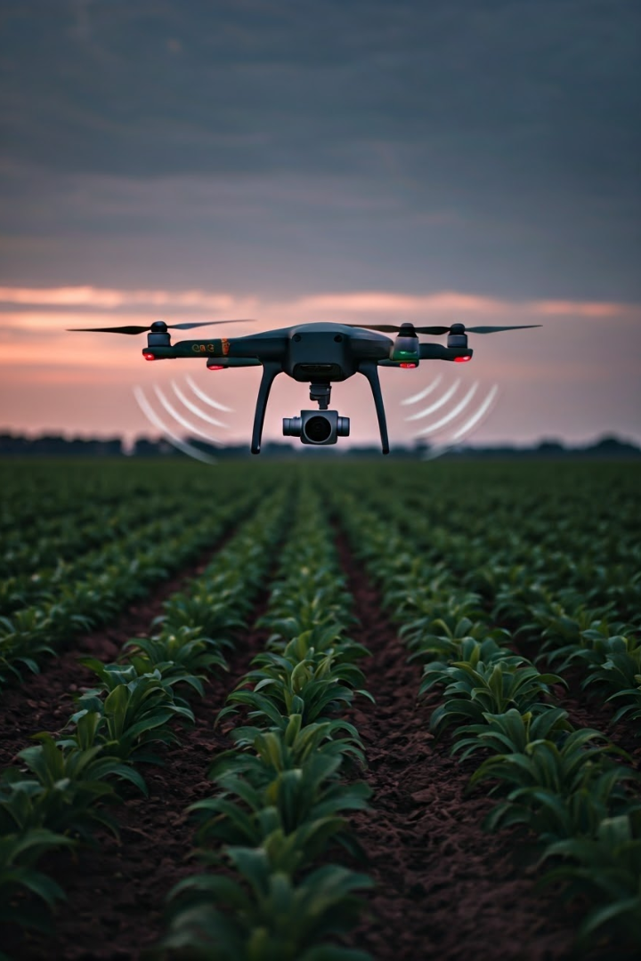
Applications in Smart Agriculture
Crop Monitoring
Secure connectivity for sensors measuring soil moisture, nutrient levels
and plant health.
Equipment Management
Tracking and controlling automated farming machinery through robust
wireless networks.
Data Collection
Ensuring integrity of agricultural data transmitted from field sensors
to central systems.

Slide 4
Smart Agriculture and LPWAN Technologies
LoRa Technology
LoRaWAN
IEEE 802.15.4
Long-range wireless protocol enabling low-power, long-distance communication for IoT devices in agriculture.
Network architecture built on LoRa, providing secure bi-directional communication for smart farming applications.
Standard for low-rate wireless networks, forming the basis for ZigBee and other agricultural IoT protocols.

Slide 5
The ’Forensic’ Area
The potential use of Wi-PY in Forensic Investigation is noteworthy. With the introduction of Law No. 3 of 9 January 2019, the so-called "anti-corruption" law, new measures were established to tackle corruption and strengthen the fight against crimes in public administration.
This allows to a potential use of Wi-PY for automating vulnerability scanning processes within a wireless network, allowing for the insertion of an exploit or targeted attacks on individual devices.

Slide 6

Wi-Fi Security Protocols
1
WEP
Outdated protocol using static keys. Easily cracked due to vulnerabilities in RC4 implementation.
2
WPA/WPA2
Improved security with TKIP and AES encryption. WPA2 is current standard for most networks.
3
WPA3
Latest protocol offering enhanced protection against password guessing and stronger encryption for public networks.

Slide 7
Objectives of the project
1
Hardware Analysis
2
Python Development
3
Vulnerability Discovery
4
Data Export
5
Result Analysis

Slide 8

Hardware Components
Raspberry Pi 3 B+
Core computing unit providing processing power and GPIO connectivity for the testing system.
GPS Module
U-Blox USB GPS module for precise geolocation of tested networks.
Alfa AWUS036NEH
High-power USB Wi-Fi adapter supporting monitor mode for packet capture and injection.
Notes:
The hardware components we used were the following:
a Raspberry Pi 3 B+ that provides processing power and connectivity for the test system.
A GPS module for geolocalization of the tested networks.
We thought that this module would also be useful for future implementations: infact
if the system was mounted on an unmanned vehicle, once it reached the chosen coordinates it could start the tests.
A USB Wi-Fi adapter that supports monitor mode for packet capture and injection

Slide 9

Software Tools & Techniques
1
Aircrack-ng Suite
Comprehensive set of tools for assessing Wi-Fi network security, including WEP/WPA key cracking.
2
Besside-ng
Automated tool for capturing WPA handshakes and cracking WEP keys on multiple networks simultaneously.
3
Nmap
Powerful network scanner used for port discovery and vulnerability assessment of target networks.
4
Custom Python Scripts
Developed to automate the testing process, coordinate hardware components, and manage data collection.
Notes:
I want to make a small premise:
the python script we developed was written completely without any help from artificial intelligence.
I apologize if there are imperfections or redundancies in the code, but I believe that human creative activity is an added value and these imperfections underline it.
We have preserved the modularity of the code by developing different "Classes" for each single action that the program must undertake.
Using system calls we were able to acquire the information necessary to test the wifi networks that we have prepared.
To do this we used both global variables and tools at our disposal such as Aircrack, Besside and Nmap.
We decided to use the nmap command for several reasons: the most important one is the possibility of using specific scripts.
In particular with Nmap Scripting Engine is possible to find security holes in all kind of systems.

Slide 10

System Operation
1
Network Detection
System scans for nearby Wi-Fi networks, identifying SSID, encryption type, and signal strength.
2
Packet Capture
Targeted networks are analysed using tools like besside-ng to capture authentication handshakes.
3
Password Cracking
Captured handshakes are processed with aircrack-ng to attempt password recovery using dictionaries.
4
Vulnerability Scanning
Nmap is utilised to identify potential security weaknesses in successfully accessed networks.
Notes:
Now let's explain step by step what the developed code does:
After starting it, the coordinates are read and the Google Maps URL is generated.
Afterwards, the existing networks are scanned and useful packets are captured.
This reading is done via 'besside-ng' which will generate a log file and two *.cap files (one file for WEP networks and one file for WPA networks).
When a useful 'handshake' is detected, aircrack-ng is immediately started.
These operations are performed for all the networks found and continue until it finds the appropriate password for the network.
In our case there are networks that we are not interested in (since they have not been set up previously), so the system refuses the scan.
Once this first phase is completed, it performs the vulnerability scan via nmap.
To do this, the program automatically connects to the previously scanned networks and starts looking for vulnerabilities in the network and its clients.
Once this process is completed, all the acquired information is transferred into a specific .csv file.

Slide 11

Data Analysis & Reporting
Security
Protocol
Password Recovered
Vulnerabilities Found
Network SSID
SOSSU
WPA2
Yes
2
MyASUS
Open
Yes
5
TP-LINK3CE9
WEP
Yes
0*
Notes:
We tested several Wi-Fi networks. They differed in security protocol and encryption.
One called "SOSSU" which uses WPA2 as authentication method.
One called "TP-LINK" which uses WEP as authentication method.
One called "Myasus" which is open.
In all of them passwords were found (obviously where passwords can be found, in our last case MYASUS is an open network)
and several vulnerabilities in their clients: TP-LINK was the exception since no client was connected.

Slide 12
Ethical & Legal Considerations
Authorised Testing Only
Data Protection
Responsible Disclosure
System should only be used on networks with explicit permission to avoid legal issues.
Strict protocols for handling and storing any captured network data to ensure privacy.
Clear guidelines for reporting vulnerabilities to network owners in a constructive manner.
Notes:
During the tests, the system tried to hack all the networks in its range and for this reason we made a series of considerations:
The system should be used only on networks with explicit authorization to avoid legal problems.
In case of acquisition of network vulnerabilities,
protocols must be guaranteed for the management and storage of all the acquired network data
(in our case we record everything in a csv file)
In case we have to do a test for other people
there must necessarily be a clear way to report the vulnerabilities to the owners of the network being tested

Slide 13

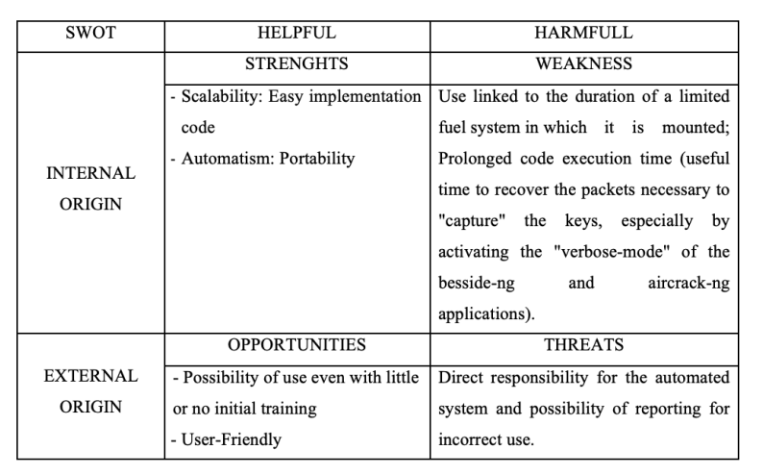
Conclusions
Notes:
So, finally we made some more considerations.
Using this system we noticed strengths and weaknesses.
The strengths are:
System scalability (the system can be implemented with other hardware and features very easily);
Ease of code implementation;
Automatic execution of tests;
Portability of the system;
The weaknesses are:
Use tied to the duration of a limited power system in which it is mounted;
Extended code execution time (time needed to retrieve the packets needed to "capture" the keys especially by activating the "verbose mode" of the besside-ng and aircrack-ng applications).
Using this system we noticed OPPORTUNITIES and THREATS
OPPORTUNITIES are:
possibility of use even with little or no initial training;
User Friendly ( it very Ease to use!)
THREATS are: Direct responsibility on the automated system and possibility of reporting for incorrect use.

Slide 14
Future Developments
AI-Powered Analysis
Incorporating machine learning for more sophisticated vulnerability detection and password cracking.
Extended Protocol Support
Expanding capabilities to test emerging wireless standards like Wi-Fi and 5G networks.
Miniaturisation
Further reducing system size for easier deployment on drones and other mobile platforms.
Continuous Learning
Developing systems to automatically update attack databases based on new security research.
Notes:
We also considered future developments such as the possibility of using artificial intelligence to test networks and
Expand capabilities to test emerging wireless standards.
We also considered the possibility of further reducing the size of the system for easier deployment on drones and other mobile platforms.

Slide 15
Thanks for the attention
Notes:
So, Thank you for your attention.
If you have any questions we will be happy to answer

